Slide 1
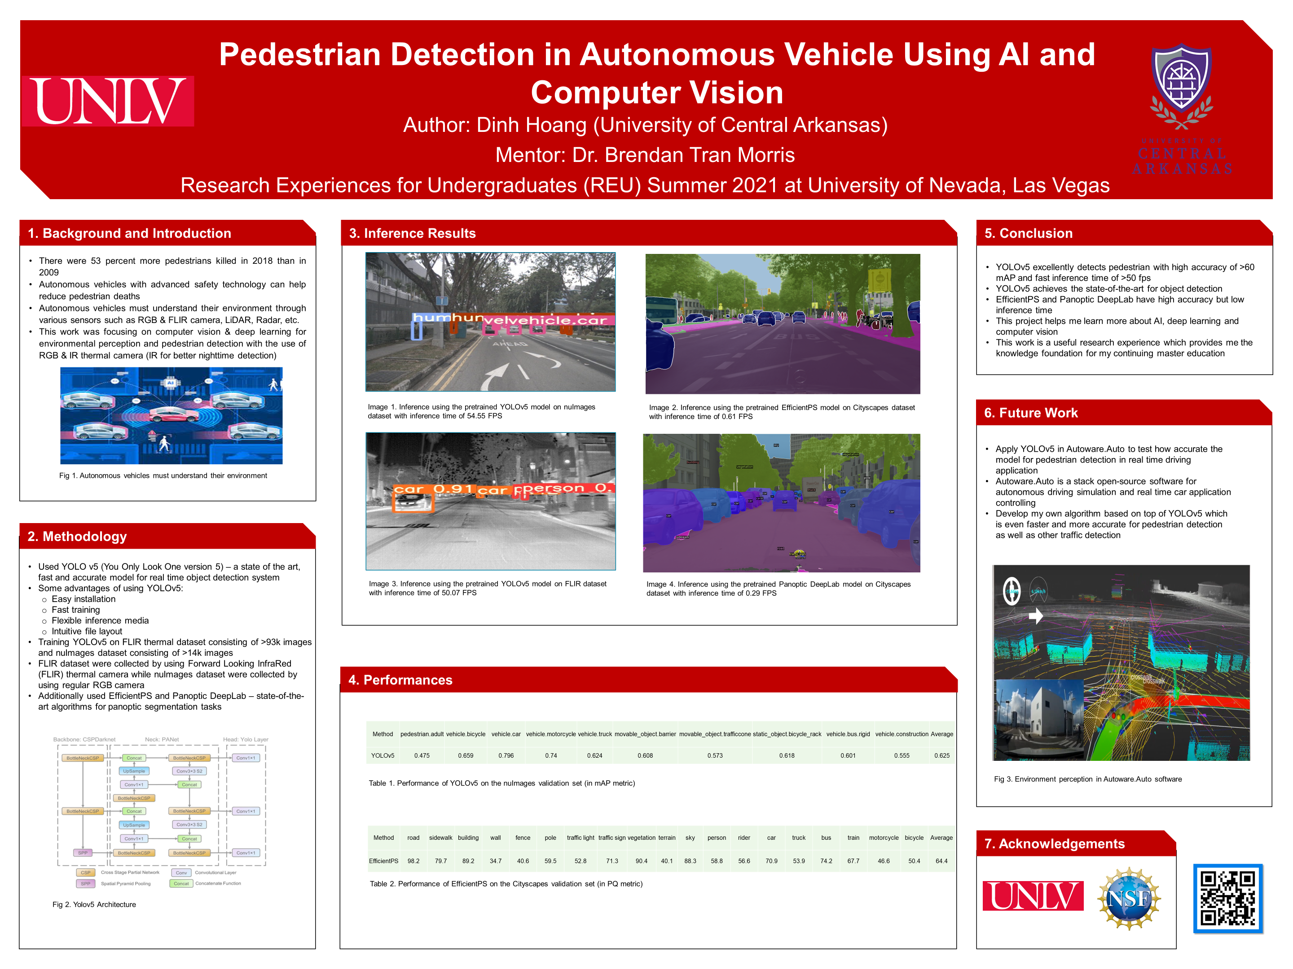


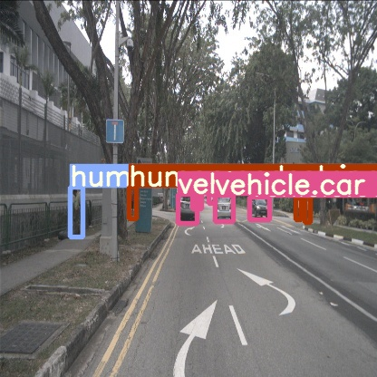
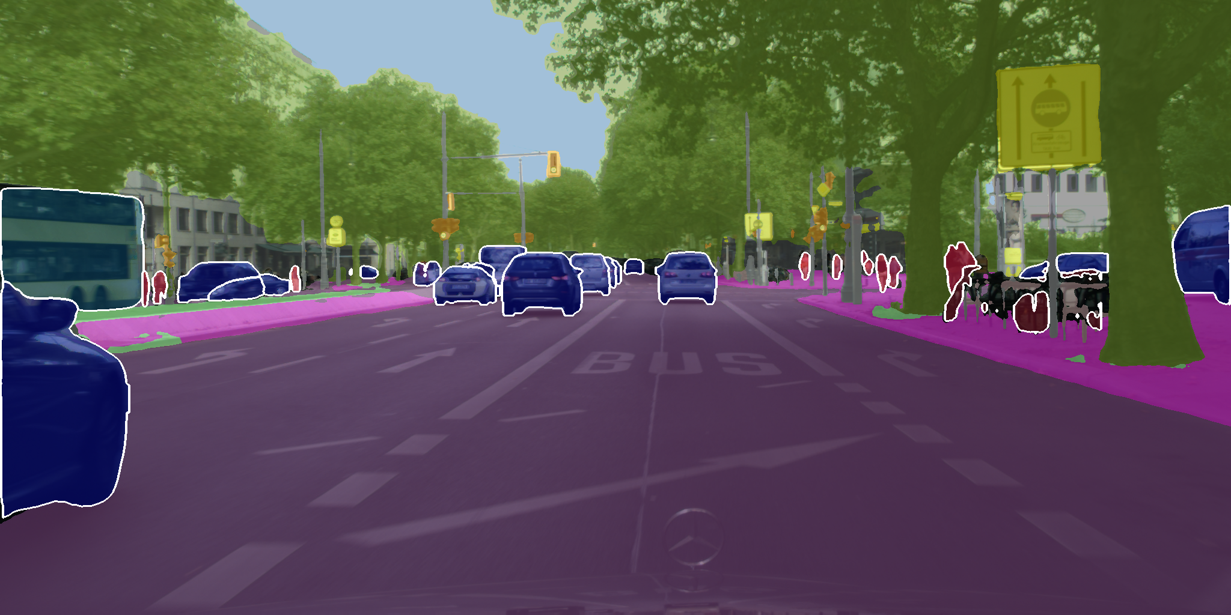
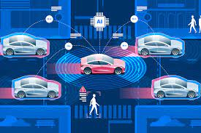
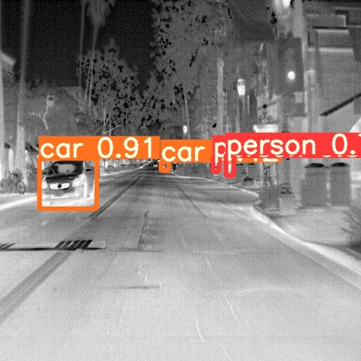
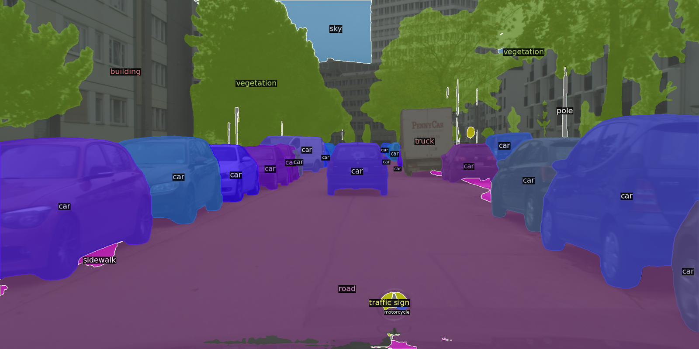
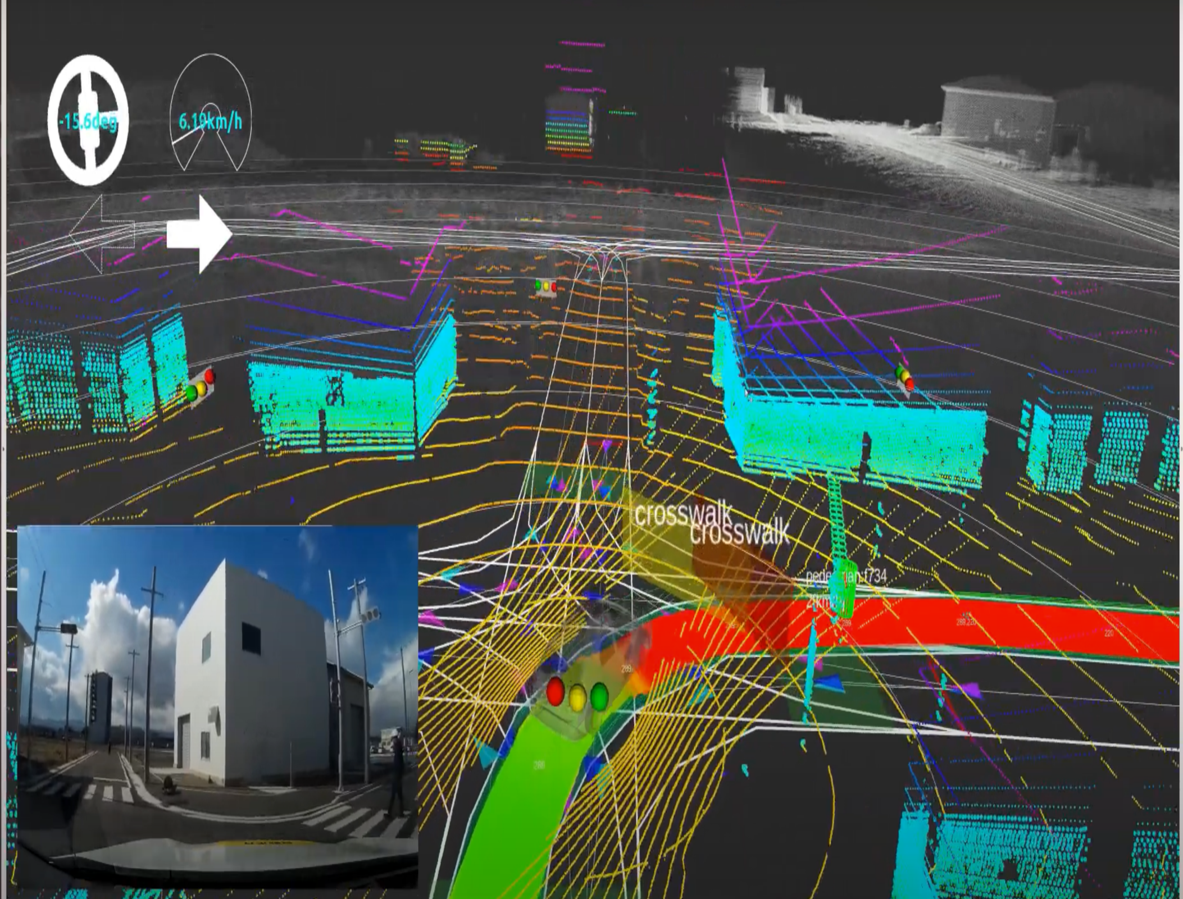
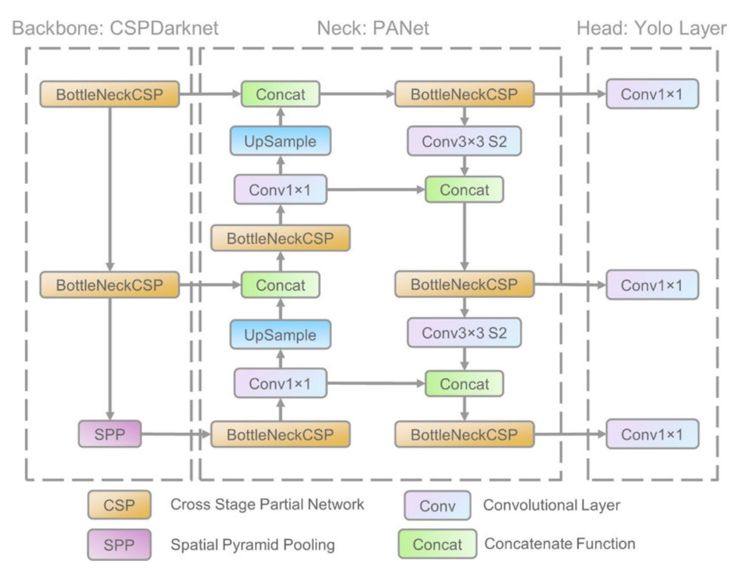


Pedestrian Detection in Autonomous Vehicle Using AI and Computer Vision
Author: Dinh Hoang (University of Central Arkansas)
Mentor: Dr. Brendan Tran Morris
Research Experiences for Undergraduates (REU) Summer 2021 at University of Nevada, Las Vegas
1. Background and Introduction
3. Inference Results
5. Conclusion
There were 53 percent more pedestrians killed in 2018 than in 2009
Autonomous vehicles with advanced safety technology can help reduce pedestrian deaths
Autonomous vehicles must understand their environment through various sensors such as RGB & FLIR camera, LiDAR, Radar, etc.
This work was focusing on computer vision & deep learning for environmental perception and pedestrian detection with the use of RGB & IR thermal camera (IR for better nighttime detection)
YOLOv5 excellently detects pedestrian with high accuracy of >60 mAP and fast inference time of >50 fps
YOLOv5 achieves the state-of-the-art for object detection
EfficientPS and Panoptic DeepLab have high accuracy but low inference time
This project helps me learn more about AI, deep learning and computer vision
This work is a useful research experience which provides me the knowledge foundation for my continuing master education
Image 1. Inference using the pretrained YOLOv5 model on nuImages dataset with inference time of 54.55 FPS
6. Future Work
Image 1. Inference using the pretrained YOLOv5 model on nuImages dataset with inference time of 54.55 FPS
Image 2. Inference using the pretrained EfficientPS model on Cityscapes dataset with inference time of 0.61 FPS
Apply YOLOv5 in Autoware.Auto to test how accurate the model for pedestrian detection in real time driving application
Autoware.Auto is a stack open-source software for autonomous driving simulation and real time car application controlling
Develop my own algorithm based on top of YOLOv5 which is even faster and more accurate for pedestrian detection as well as other traffic detection
Fig 1. Autonomous vehicles must understand their environment
Fig 1. Autonomous vehicles must understand their environment
2. Methodology
Used YOLO v5 (You Only Look One version 5) – a state of the art, fast and accurate model for real time object detection system
Some advantages of using YOLOv5:
Easy installation
Fast training
Flexible inference media
Intuitive file layout
Training YOLOv5 on FLIR thermal dataset consisting of >93k images and nuImages dataset consisting of >14k images
FLIR dataset were collected by using Forward Looking InfraRed (FLIR) thermal camera while nuImages dataset were collected by using regular RGB camera
Additionally used EfficientPS and Panoptic DeepLab – state-of-the-art algorithms for panoptic segmentation tasks
Image 3. Inference using the pretrained YOLOv5 model on FLIR dataset with inference time of 50.07 FPS
Image 4. Inference using the pretrained Panoptic DeepLab model on Cityscapes dataset with inference time of 0.29 FPS
4. Performances
Method | pedestrian.adult | vehicle.bicycle | vehicle.car | vehicle.motorcycle | vehicle.truck | movable_object.barrier | movable_object.trafficcone | static_object.bicycle_rack | vehicle.bus.rigid | vehicle.construction | Average
YOLOv5 | 0.475 | 0.659 | 0.796 | 0.74 | 0.624 | 0.608 | 0.573 | 0.618 | 0.601 | 0.555 | 0.625
Table 1. Performance of YOLOv5 on the nuImages validation set (in mAP metric)
Fig 3. Environment perception in Autoware.Auto software
Method | road | sidewalk | building | wall | fence | pole | traffic light | traffic sign | vegetation | terrain | sky | person | rider | car | truck | bus | train | motorcycle | bicycle | Average
EfficientPS | 98.2 | 79.7 | 89.2 | 34.7 | 40.6 | 59.5 | 52.8 | 71.3 | 90.4 | 40.1 | 88.3 | 58.8 | 56.6 | 70.9 | 53.9 | 74.2 | 67.7 | 46.6 | 50.4 | 64.4
7. Acknowledgements
Table 2. Performance of EfficientPS on the Cityscapes validation set (in PQ metric)
Fig 2. Yolov5 Architecture
Notes:
This Scientific Poster Template Is Provided By MakeSigns
Enter A Title And Add Logos To Your Poster
Add Author Names and Information
Include University or Department Names if Needed
Based on 2 ponderingpeacock_48x36
Draft title: Promote Pedestrian Safety by Detecting Pedestrian in Autonomous Vehicle using AI and Computer Vision

